Slide 1



UNIT 2
Lesson 6
What’s with you?
Part 3

Slide 2
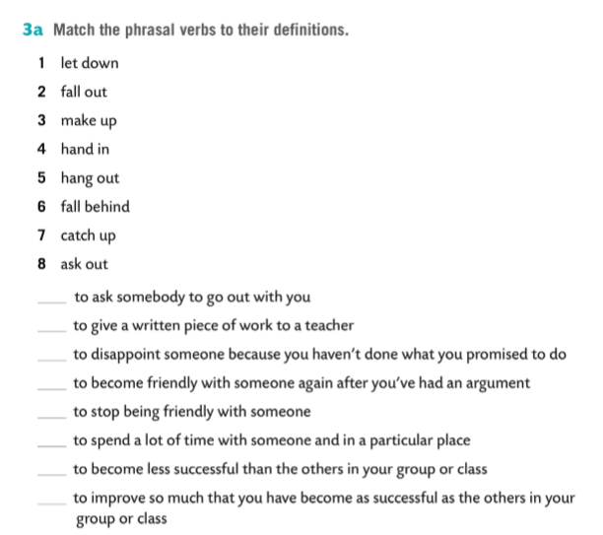
Group the expressions and say what topics they refer to.
school family matters relationships
Answer the questions.
What do you do when you have a problem?
Who do you turn to for help?
Who do you discuss them with?
What’s the best way to deal with problems?
8
4
1
3
2
5
6
7

Slide 3
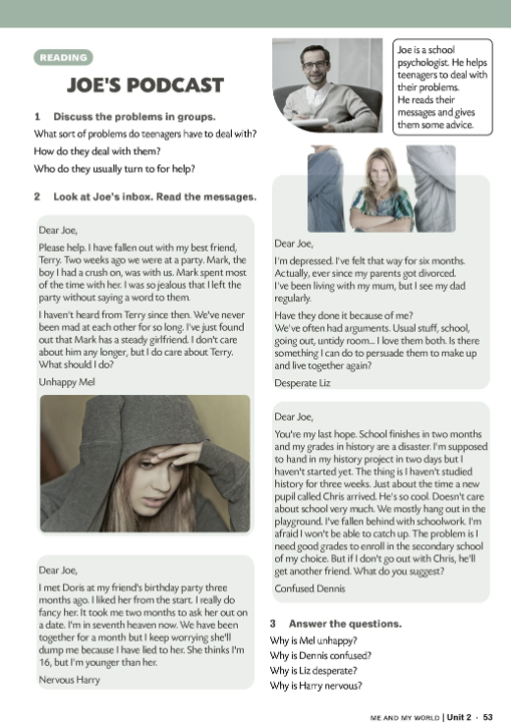
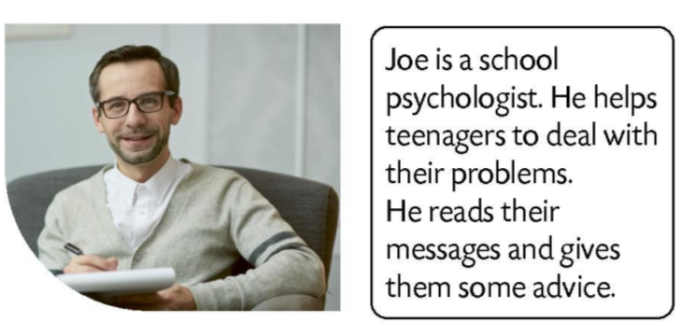
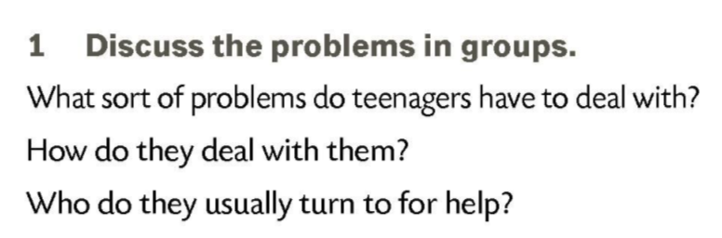
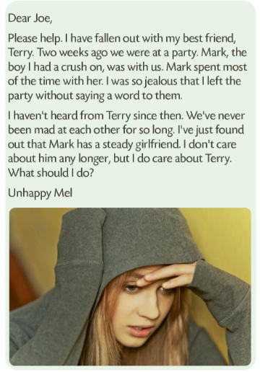


Slide 4
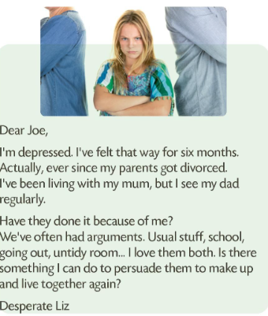
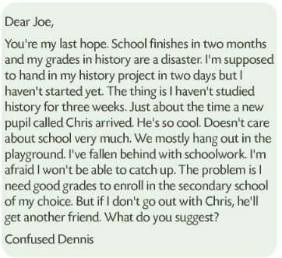
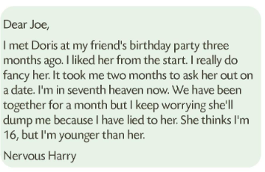
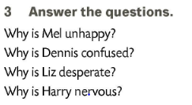

Slide 5
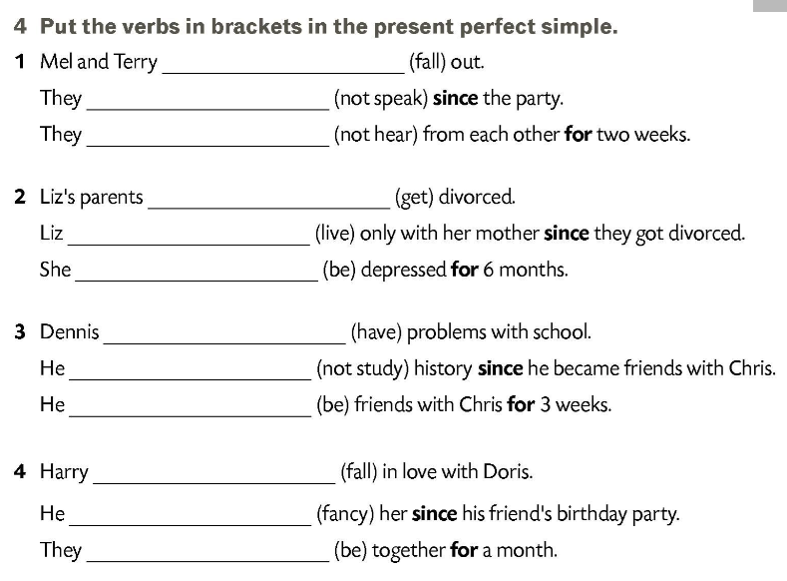
have fallen
haven’t spoken
haven’t heard
have got
has lived
has been
has had
hasn’t studied
has been
has fallen
has fancied
have been

Slide 6
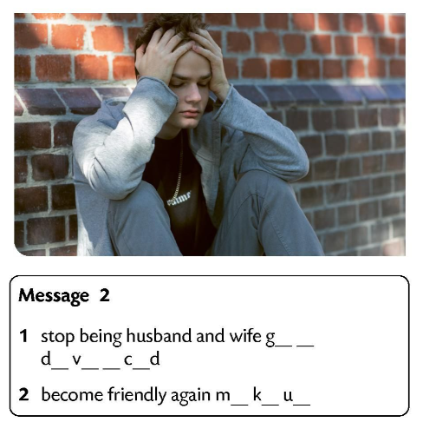
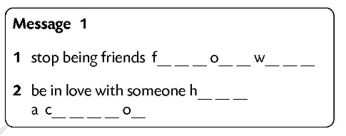
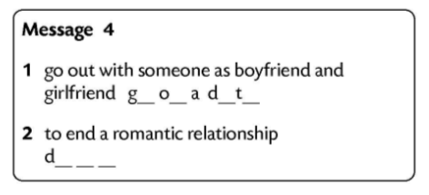
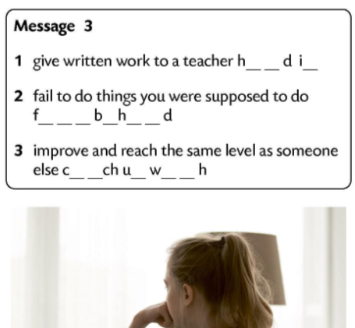
fall out with
go out on a date
have a crush on
dump
hand in
fall behind
catch up with
get divorced
make up

Slide 7
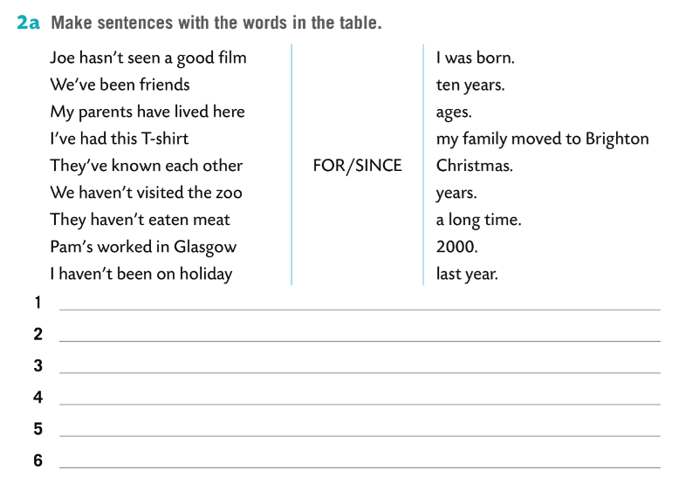
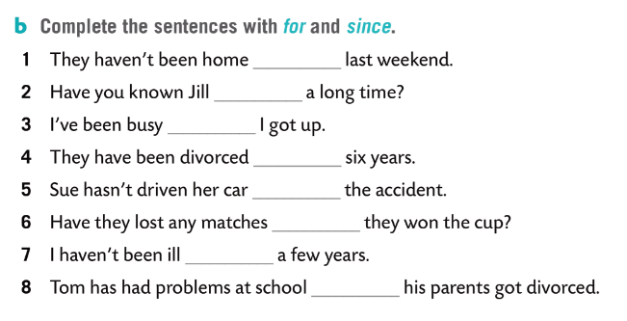
since
for
since
for
since
since
for
since

Slide 8
I’ve been friends with...
I’ve lived ...
I haven’t seen ...
I’ve known ....
I’ve had ...
I haven’t visited ...
I haven’t eaten ...
I haven’t been on holiday ...
FOR
SINCE

